Slide 1
Code Cracking: Decoding Cancer Causing Mutations
Northwest Association for Biomedical Research
Notes:
Slide deck authored by Wendi Russac, Northwest Association for Biomedical Research.

Slide 2
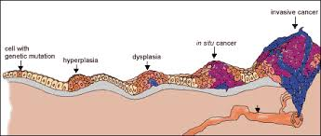
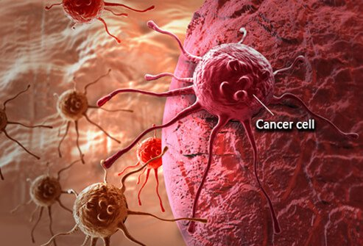
Why is cancer such an important topic?
Notes:
Why do you think we are talking about cancer? Do you know anyone who has cancer? (Solicit student feedback and discussion.)
Images from science.education.nih.gov, oncologynews.com.au

Slide 3
Cancer: Key Facts
An estimated 1,735,350 new cases of cancer were estimated to be diagnosed in the United States in 2018 with 609,640 people dying from the disease.
Estimated expenditures in the United States in 2017 were $147.3 billion.
Globally, cancer is the second leading cause of death, and was responsible for an estimated 9.6 million deaths in 2018. Globally, about 1 in 6 deaths are due to cancer.
The economic impact of cancer is significant and is increasing. The total annual economic cost of cancer in 2010 was estimated at approximately $ 1.16 trillion in US dollars.
Source: https://www.cancer.gov/about-cancer and https://www.who.int/news-room/fact-sheets/detail/cancer
Notes:
We are talking about cancer because it is a really big deal. (Read slide statistics.) These numbers represent human lives and community resources. In the US alone, people die of cancer at a rate greater than one per second. These numbers represent moms, dads, sons, daughters, our relatives, friends and perhaps ourselves. The human and financial burden of cancer is enormous and impacts us all.

Slide 4
Cancer: Myths and Misconceptions
What do you believe?
Notes:
We’ve all picked up some general ideas about cancer from family, friends, tv, and the internet - and maybe even formed some specific beliefs. Some of your beliefs are probably right and others may be totally wrong. Let’s go through them. (Full Cancer T/F slide deck may be used here.)

Slide 5
Cancer: Key Facts
Cancer is a genetic disease caused by changes in genes that normally control the growth and death of cells.
It is an accumulation of these mutations that leads to uncontrolled cell proliferation. The current cancer model suggests that a single cell must acquire a minimum of six mutations in genes that control cell proliferation to become cancerous.
Certain lifestyle and environmental factors can change, or mutate, normal genes into genes that allow and promote the growth of cancer.
Notes:
Cancer is caused by an accumulation of mutations in genes that normally control the growth and death of cells. Certain lifestyle and environmental factors can change, or mutate, normal genes into genes that allow and promote the growth of cancer.

Slide 6
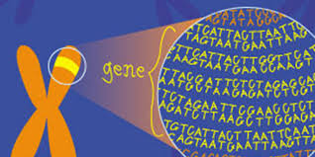
Overall Driving Question
How can an understanding of genetics help us investigate why cancer (both rates of incidence and cancer related deaths) disproportionately affects people in different countries of the globe?
Notes:
For the next few days we are going to look more closely at cancer as a real-life application of our knowledge about DNA as the carrier of biological information. Then we’ll use this scientific knowledge to help us understand why, although we are all at risk of acquiring cancer, different populations bear a disproportionate burden of cancer.
Images from hsph.harvard.edu, amnh.org

Slide 7
Day One: Investigative Questions
What causes cancer?
What are the exposures and events that lead to cancer?
Are there preventative measures that can help reduce cancer risks?
Notes:
Some of the questions we will be asking today.

Slide 8
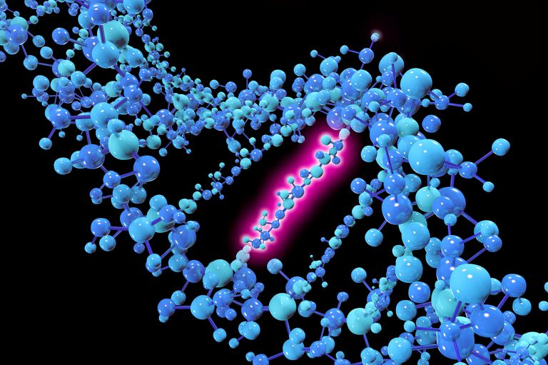
Where do these cancer causing mutations come from?
Notes:
Ask students: What types of events might cause these mutations? Can you think of behaviours or activities that you have been warned about because they might cause cancer?
Cancer risk factors fall into 3 categories: physical, chemical and biological. Do these categories help you think of any risk factors? What category does each type of event fall into?
Image from thoughtco.com

Slide 9
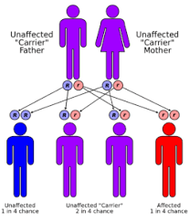
Inherited Mutations
5-10% of cancers are considered hereditary. The cancer itself is not inherited. The increased chance of developing cancer is inherited.
Some examples of inherited cancers:
Breast-ovarian cancer syndrome 1 results from an abnormal change in the BRCA1 gene. Female family members have an estimated 80 percent lifetime chance of developing breast cancer and a 40 percent to 60 percent lifetime chance of developing ovarian cancer.
Familial adenomatous polyposis is a hereditary colon cancer syndrome that results from an abnormal alteration in the APC gene.
Hereditary nonpolyposis colon cancer (HNPCC) is a hereditary colon
cancer syndrome resulting from an abnormal change in one of at
least four genes.
Notes:
If students mentioned inherited mutations let them know they were right. Only a very small number of cancers are considered hereditary. The cancer itself is not inherited - just an increased risk. Cancer results from an accumulation of mutations in a single cell. A person with an inherited risk factor starts with a predisposing mutation in every cell.
Image from openpressbooks.com

Slide 10
Acquired Mutations
The majority of cancer-causing genetic changes are acquired
Result of random errors during DNA replication (spontaneous).
Result of exposure to environmental carcinogens that damage DNA.
Aging is the biggest risk factor for cancer. The longer you live the more likely you are to get cancer.
Notes:
The vast majority of cancer-causing mutations are acquired.

Slide 11
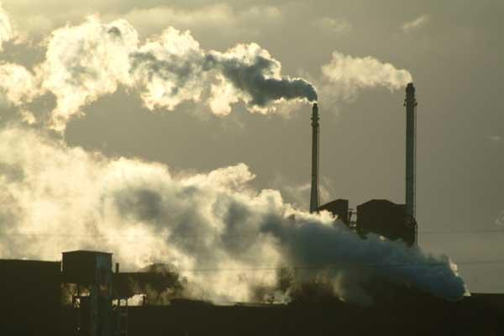
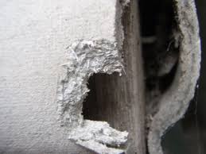
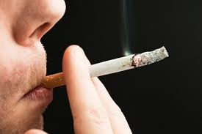
Non-Hereditary Causes
Induced Mutations:
Alcohol, drugs, tobacco
Cancer-causing chemicals from various sources
Chronic inflammation
Diet
Hormones
Infectious agents
Obesity
Radiation
Sunlight
Spontaneous:
Result of unrepaired random errors during natural biological processes. These occur at very low levels even in healthy organisms.
Notes:
Comment on any risk factors students correctly identified during the brainstorming and point out any they missed.
Ask if they can tell which of the three broad classifications they fall into: Biological (infectious diseases, hormones, inflammation, obesity); Chemical (Alcohol, drugs, tobacco, air pollution, off-gassing, possibly food additives); Physical (Radiation, sunlight).
Spontaneous: Note that these are unavoidably acquired at low levels in all organisms.

Slide 12
Preventing Cancer
What are some things you can do to prevent cancer?
Are there some prevention measures more difficult than others?
Does where you live have anything to do with these factors?
Do you think that people around the world have the same risk factors for cancer? Why or why not?
What percent of cancers do you think could be prevented by avoiding the major risk factors?
Notes:
Introduce questions and ask students to brainstorm answers.

Slide 13
Cancer Key Facts
About one third of cancer deaths are considered preventable
Around one third of deaths from cancer are due to the 5 leading behavioral and dietary risks: high body mass index, low fruit and vegetable intake, lack of physical activity, tobacco use, and alcohol use.
Tobacco use is the most important risk factor for cancer and is responsible for approximately 22% of cancer.
Cancer causing infections, such as hepatitis and human papilloma virus (HPV), are responsible for up to 25% of cancer cases in low- and middle-income countries.
Notes:
Note that although one third of cancer deaths are a result of the 5 leading risk factors this just refers to overall death rates which only represent a percentage of the actual cancer cases that are attributable to these factors.
Based on these key facts ask students why they think certain risk factors vary in high and low resource countries? (Students might note that the 5 leading behavioral risks are more prevalent in high resource countries, lower resource countries have more limited access to vaccines and antibiotics.)

Slide 14
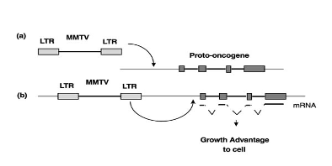
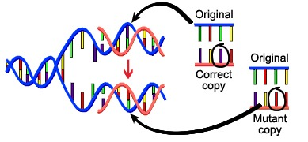
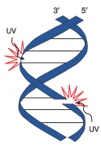
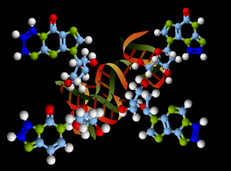
These exposures increase the risk of cancer because of their capacity to cause: DNA Damage
Chemical
Biological
Physical
Notes:
Of the potential risk factors we discussed: diet, radiation, infectious diseases, etc. all increase the risk of acquiring cancer because of they can cause DNA damage.

Slide 15
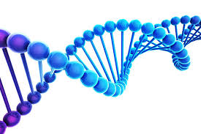
How does DNA carry the genetic information that determines a cell’s fate?
Videos
“What is DNA and how does it work?” (5 minutes)
https://www.youtube.com/watch?v=zwibgNGe4aY
“What is a gene?” (5 minutes)
https://www.youtube.com/watch?v=5MQdXjRPHmQ
Notes:
Students will need a basic understanding of DNA transcription and translation as a foundation for the rest of the unit. These brief videos can serve as either a review or brief introduction. They are short, fast-paced, and cover the basics quite well.

Slide 16
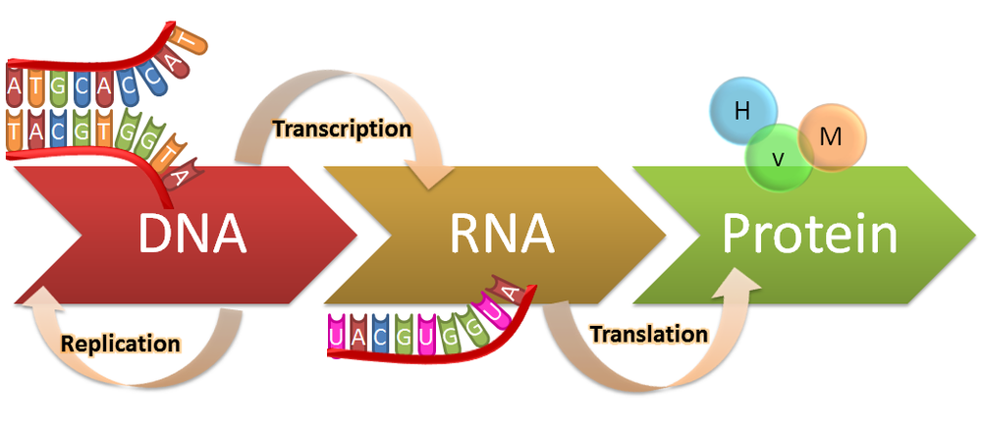
Central Dogma
Genes code for proteins, which are the workhorses of the cell.
Proteins are responsible for a cell’s structure, function, and regulation.
Notes:
Give a brief explanation of the central dogma: DNA is transcribed to RNA, RNA is translated to proteins. (DNA makes RNA, RNA makes proteins). It describes the process by which the information that is coded in DNA is used to make the proteins that are responsible for a cells structure, function and regulation.
Image from medium.com

Slide 17
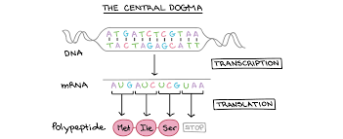
Let’s Start Decoding!
M I S
Notes:
(Students should have the Protein Synthesis handout). Review the instructions on the handout with them and then walk them through the example on the next slide.
Image from khanacademy.com

Slide 18
The Genetic Code
The genetic code is a set of rules by which information encoded on DNA is used to make proteins.
Proteins are made up of amino acid sequences. The specific amino acid sequence for each unique protein is determined by the sequence of bases.
By looking at the order of bases on a DNA sample we can read, or translate, the code and determine the structure of a protein.
Notes:
Remind students that proteins are made up of amino acid sequences. The specific amino acid sequence for each unique protein is determined by the sequence of DNA bases. These DNA bases are read in triplets, or “codons” and each codon, or set of three bases codes for a specific amino acid.

Slide 19
Protein Synthesis Decoder
DNA ------> GAA TAG AAA CTT ACT TAG AGC ATT CCT GCC CTT
mRNA ---> CUU AUC UUU GAA UGA AUC UCG ... ... ... ... ... ...
Amino Acid -> Leu Iso Phe Glu ... Iso ... ... ... ... ... ... ... ... …
Symbols ----> L I F E ... I . . . . . . . .
Notes:
Follow the handout instructions to guide them through this example. Note that all amino acids have both a 3 letter abbreviation and a 1 letter abbreviation. Their final translation will be to the 1 letter abbreviation. After demonstrating, have the students complete the handout.

Slide 20
Optional Online Protein Decoder
Go to:
https://skaminsky115.github.io/nac/DNA-mRNA-Protein_Converter.html
Click on DNA
Enter your sequence directly or with the 4 letter keyboard
Click on Convert
Scroll down to read your output
Notes:
This is a simple program written by a high school student that will transcribe and translate a DNA sequence. Students can open the link and enter their DNA sequences into the program for a quick transcription/translation. Students just need to match the resulting 3 letter amino acid abbreviations to the 1 letter abbreviations. Example: AGA ACA TAA CTC TTA ACA CTC TAA AGA CCA GCA CTC CGA TGA Decodes to: Science is great

Slide 21
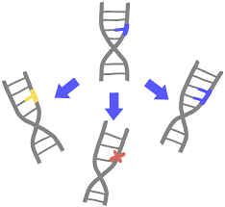
Day Two: Investigative Questions
What are gene mutations?
What types of genes are mutated in cancer cells?
Notes:
Ask students what they think would happen if there was a mutation (mistake in sequence resulting in a permanent change in the DNA’s code).
Students brainstorm and teacher helps them to understand that mutations can lead to a change in the cell’s structure, function, or regulation.
Image from innovativegenomics.org

Slide 22
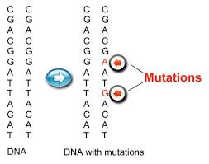
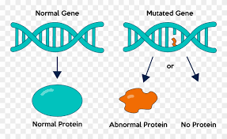
Mutation
A change in the DNA sequence, either due to mistakes during replication or as a result of environmental factors.
What happens if a cell’s DNA acquires a mutation?
Notes:
Review mutation definition. The next 2 slides discuss some of the most common mutation types.
Images from nuclear-news.net,

Slide 23
Substitutions or Point Mutations
A substitution is a mutation that exchanges one base for another (i.e., a change in a single "chemical letter" such as switching an A to a G). Such a substitution could:
Change a codon to one that encodes the same amino acid and causes no change in the protein produced. These are called silent mutations.
Change a codon to one that encodes a different amino acid and cause a small change in the protein produced. For example, sickle cell anemia is caused by a substitution in the beta-hemoglobin gene, which alters a single amino acid in the protein produced. This is a missense mutation.
Change an amino-acid-coding codon to a single "stop" codon and cause an incomplete protein. This can have serious effects since the incomplete protein probably won't function. This is a nonsense mutation.
Source: https://evolution.berkeley.edu
Notes:
Substitution mutations are the most common type of gene mutation. Note the 3 different forms: Silent: no change in the protein. Missense: the resulting protein has an an altered function. Nonsense: an incomplete protein without function. Point out that the results of a single base pair substitution can range from harmless to catastrophic.

Slide 24
Insertions and Deletions
Insertion
Insertions are mutations in which extra base pairs are inserted into a new place in the DNA.
Deletion
Deletions are mutations in which a section of DNA is lost, or deleted.
Frameshift
Since protein-coding DNA is divided into codons three bases long, insertions and deletions can alter a gene so that its message is no longer correctly parsed. These are the most serious types of mutations since the sequence can no longer be read correctly to produce a functional protein.
Source: https://evolution.berkeley.edu
Notes:
Insertions and deletions, also called “indels”, are the most serious type of mutations because they cause a “frameshift”.The example on the slide illustrates how a change in reading frame can result in a nonsense sequence.

Slide 25
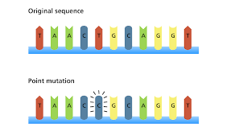
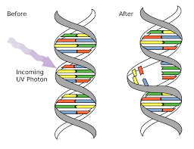
Decoding Mutations
Notes:
Students should have the Mutation handout to complete. Depending on the time frame you may want to review the steps of the previous decoding activity.
Images from yourgenome.org, mccarrison.com

Slide 26
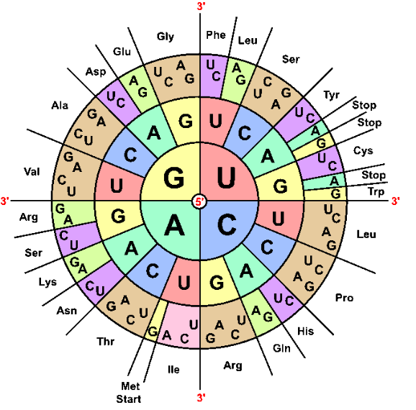
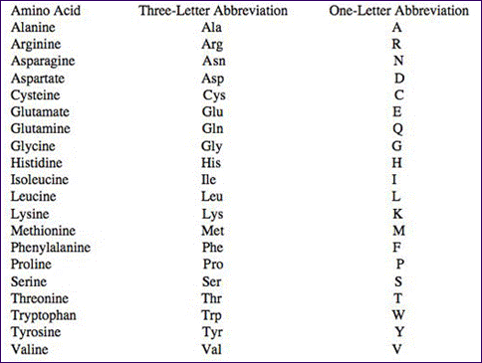
Decoding Mutations
Following the same procedure you followed during the decoding activity (DNA to mRNA to Amino Acid), decode the original and mutated sequences and identify them as one of the three types of mutations listed above. If it is a point mutation, try and note whether it is a missense, silent or nonsense mutations.
The original DNA sequence is: TGCGTGCTTAAGCGGTGTACACGTTGC
DNA: TGC GTG CTT AAG CGG TGT ACA CGT TGC
mRNA: ACG CAC GAA UUC GCC ACA UGU GCA ACG
Amino acid: Thr His Glu Phe Ala Thr Cys Ala Thr
Symbols The fat cat
Notes:
Depending on how much time has gone by you may want to quickly review the protein coding activity. Point out that the first sequence provided codes for the normal protein. The following sequences are the mutated versions so once they’ve solved this first sequence all they need to do is identify the codon with the mutation and see how it changes the sentence.

Slide 27
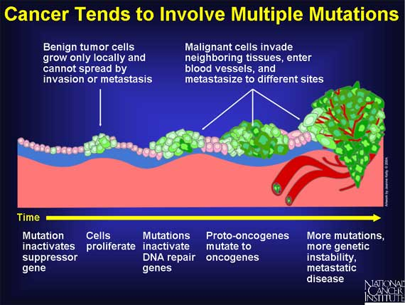
Cancer Key Facts
The human genome has approximately 30,000 genes but only a small number of them have been associated with cancer.
Usually a cell must accumulate at least six mutation in these specific genes before it becomes cancerous.
Notes:
Only a small number of genes in the human genome are associated with cancer. What types of genes are mutated in cancer? (Overview on next slide.)
Image from ubooks.com

Slide 28
The types of genes that are mutated in cancer cells can be broadly classified into two groups.
Oncogenes are the mutated form of proto-oncogenes which normally code for proteins that enhance cell division or inhibit normal cell death. Mutated oncogenes result in cells that always have a “green light” for growth. (Gas pedal always down).
Tumor suppressors genes are normal genes that slow down cell division, repair DNA mistakes, or tell cells when to die. Mutated oncogenes never turn on the “red light”. (No brakes).
Growth regulation genes code for proteins that slow down cell growth.
Tumor repair genes code for proteins whose normal function is to correct errors that arise when cells duplicate their DNA prior to cell division. Many are tumor suppressor genes.
Apoptosis genes code for proteins that trigger “cellular suicide” and can eliminate potentially cancerous cells.
Notes:
Review information on slide with students.

Slide 29
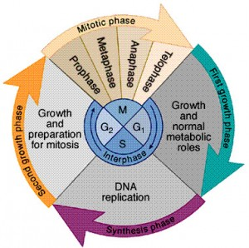
Proto-oncogenes, tumor suppressor genes, and DNA repair genes normally regulate the cell cycle
Cell Cycle Regulation is
required for normal cell growth
Credit: www.robertlfurler.com
Notes:
Cancer is caused by uncontrolled cell division. Its development and progression are usually linked to a series of mutations in genes that control the cell cycle.

Slide 30
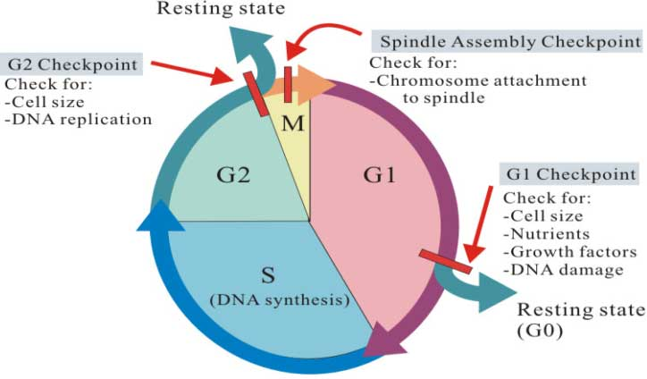
Cell Cycle Regulation occurs at checkpoints
Credit: Gleesonbiology.pbworks.com
Notes:
The genes that control cell cycle checkpoints play an important role in cancer development.

Slide 31
Cell Cycle Exploration
Go to:
https://media.hhmi.org/biointeractive/click/cellcycle
Start by reading the “Background” tab.
Click on the “Cell cycle phases” in the middle purple circle and explore each phase starting with G1.
Click on the “Cell cycle regulators and cancers” in the middle circle and explore each phase again. Can you identify any oncogenes or tumor suppressor genes?
Answer the questions on the worksheet.
Notes:
Students should have the following worksheet before independently accessing the link on the slide. https://www.biointeractive.org/sites/default/files/Cellcycle-Overview.pdf

Slide 32
Optional Cell Cycle Exploration
Go to:
http://www.mhhe.com/biosci/genbio/virtual_labs_2K8/labs/BL_03/index.html
Explore and answer the questions on the worksheet.
Notes:
Optional virtual lab: Students can look beyond the molecular level to how these genetic changes manifest on an observable level in cell samples from normal tissues and cancer tissues and calculate the difference in mitotic index which is an indicator of the number of cells actively dividing. Cancer cells have a higher mitotic index. The mitotic index is an important prognostic tool. Provide worksheet from link: https://www.fsusd.org/cms/lib03/CA01001943/Centricity/Domain/2127/Cancer%20and%20Cell%20Cycle%20Virtual%20Lab.docx

Slide 33
Day Three: Investigative Questions
What factors might account for disparities in cancer types and rates in different countries around the world?
Given the limited funding dedicated to non-communicable (not infectious) diseases around the world, how could those resources best be spent?
Notes:
Students should have been provided with the student handout “Socioeconomics and Cancer” as preparatory reading for this lesson.

Slide 34
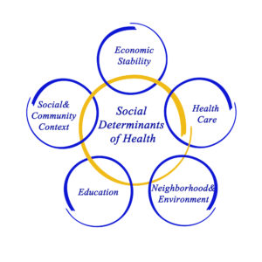
Socioeconomics and Cancer
What types of factors do you think define a person’s socioeconomic status?
Do you think these factors can affect a person’s health? If so, in what ways?
Do people who live in different parts of the world have the same issues? What factors might be different?
Additional Optional Reading
https://www.cancer.gov/about-cancer/understanding/disparities
Notes:
Facilitate a discussion about how socioeconomic factors can impact a person’s health. Students could Turn and Talk first before holding a whole class discussion. What do students wonder about? What data would they need to answer those questions? Additional information on cancer disparities and contributing factors is available from the National Cancer Institute. This would make a great additional student reading if you would like to go into more depth on this topic.
Image from hcinnovationgroup.com

Slide 35
Global Cancer Mini-Project
A few places to start your final project research:
https://www.ncbi.nlm.nih.gov/books/NBK54028/
https://www.uicc.org/news/new-global-cancer-data-globocan-2018
http://www.healthdata.org/gbd
https://www.who.int/cancer/about/facts/en/
http://gco.iarc.fr/
https://www.who.int/news-room/fact-sheets/detail/cancer
Notes:
Introduce the mini-project as outlined in the lesson plan. The mini-project extends students’ focus from cancer as a molecular disease to thinking about the global burden of cancer as a disease. Share these resources to use as a starting point for their research. This project can be extended to an additional class period, if desired, by providing additional time for in-class research and/or by asking students to also complete the optional Student Handout: Global Health Disparities. This handout engages students in activities that are a great lead-in to the mini-project.

Slide 36
Codon Wheel

