Slide 1
Cancer: Myths and Misconceptions
What do you believe?
Notes:
Most of us are familiar with the word “cancer” and have a general idea about what of the disease is. We have also picked up some other ideas surrounding cancer that may or may not be true. Let’s take a look at some of these ideas.

Slide 2
Cancer: True or False?
1. The rates of cancer deaths in the United States are increasing. T F
2. Cancer is contagious. T F
3. Lunchmeat can cause cancer. T F
4. There are over one hundred types of cancer. T F
5. Unhealthy lifestyle choices when you are young don’t affect your chances of
getting cancer when you are older. T F
6.Cancer cells can grow forever. T F
7. Cancer cells grow and divide in a controlled fashion. T F
8. We currently have cures for cancer, but the medical industry keeps them from the
public because they make so much money treating cancer patients. T F
9. Cancer develops because of changes in our DNA that result in abnormal gene function. T F
Notes:
Here are some of the issues we are going to look at to see if they are true or not. Let’s go through these one by one. (This may have been shared with students as a handout to answer independently or in group work. It can also be presented during virtual class time.)

Slide 3
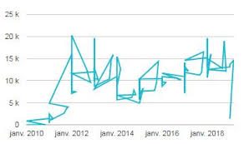
Cancer: True or False?
The rates of cancer deaths in the United States are increasing.
? ?
Notes:
Solicit student feedback or ask for a show of hands if they believe this is true.
Image from support.google.com

Slide 4
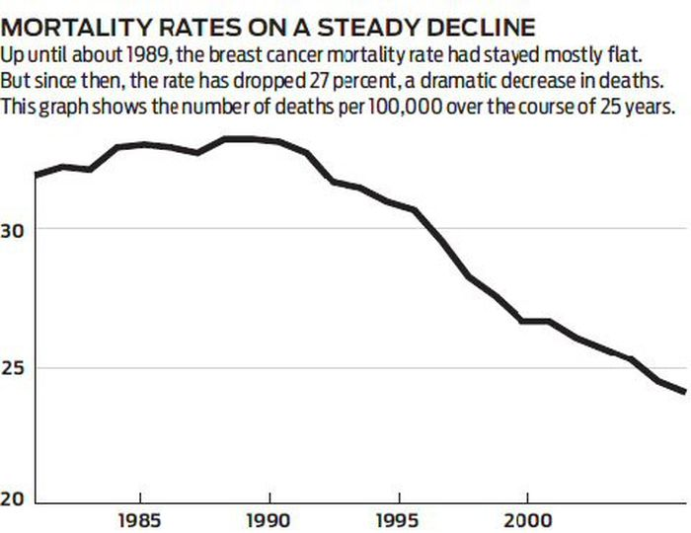
False
Notes:
False. According to annual statistics reporting from the American Cancer Society, the death rate from cancer in the US has declined steadily over the past 25 years. As of 2016, the cancer death rate for men and women combined had fallen 27% from its peak in 1991. This decline translates to about 1.5% per year and more than 2.6 million deaths avoided between 1991 and 2016. Although cancer diagnoses have increased, survival rates have increased at an even greater rate.
Image from al.com

Slide 5
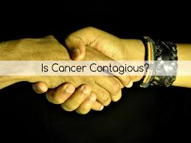
Cancer: True or False?
Cancer is contagious.
Notes:
Solicit student feedback or ask for a show of hands if they believe this is true.
Image from cancerhealercenter.com

Slide 6
False
Cancer is not
Contagious
However, certain diseases may increase your risk of acquiring cancer.
Notes:
False. You cannot "catch” cancer. Cancer does not spread from one person to another. However, certain contagious viruses such as HPV or hepatitis, or bacteria such as helicobacter pylori, can cause diseases that increase your risk of developing cancer.
Images from: i2-prod.coventrytelegraph.net and post.healthline.com

Slide 7
Cancer: True or False?
Lunchmeat can cause cancer.
Notes:
Solicit student feedback or ask for a show of hands if they believe this is true. Image from: meatmastersms.com

Slide 8
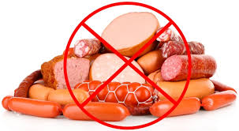
True
All processed meat can increase your risk of getting cancer.
Notes:
True. Research shows that eating processed meats like bacon and cold cuts can increase your chances for stomach and colorectal cancer. Processed meat includes hot dogs, ham, bacon, sausage, and some deli meats. It refers to meat that has been treated in some way to preserve or flavor it. Processes include salting, curing, fermenting, and smoking. Consuming these products does not mean you will get cancer, but it does increase your overall risk of getting it.
Image from drcarney.com

Slide 9
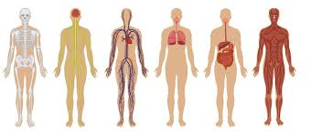
Cancer: True or False?
There are over one hundred types of cancer.
Notes:
Solicit student feedback or ask for a show of hands if they believe this is true.
Image from cdn.mos.cms.futurecdn.net

Slide 10
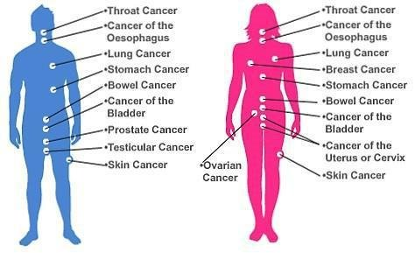
True
Notes:
True. Any replicating cell can become cancerous. Different cancer types are named after the type of tissue where they arise. This slide only shows some of the possible cancers. For example, it doesn’t list brain cancer, leukemias, or lymphomas.
Image from kimajafarwani.blogspot.com

Slide 11
Cancer: True or False?
Unhealthy lifestyle choices when you are young don’t affect your chances of
getting cancer when you are older.
Notes:
Solicit student feedback or ask for a show of hands if they believe this is true.
Image from momjunction.com

Slide 12
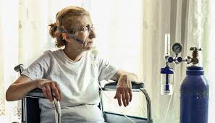
False
Notes:
False. Cancer is usually the result of years of exposure to a variety of risk factors. Avoiding some of these risk factors reduces your overall cancer risk.
Images from futurity.org, iconfinder.com, therapy-a.com

Slide 13
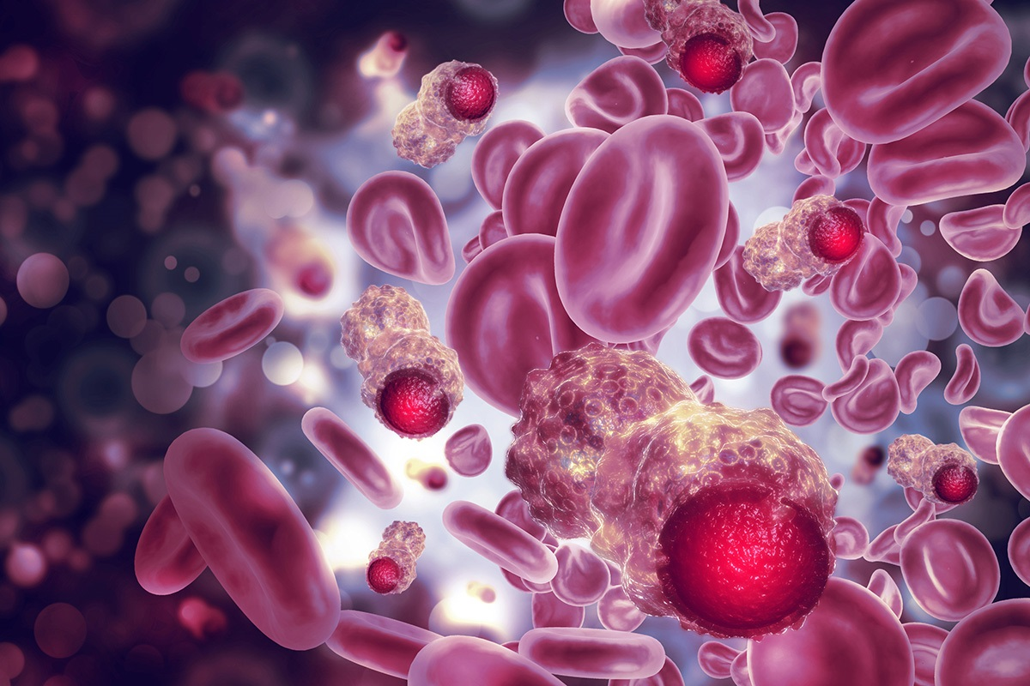
Cancer: True or False?
Cancer cells can grow forever.
Notes:
Solicit student feedback or ask for a show of hands if they believe this is true.
Image from physicsworld.com

Slide 14
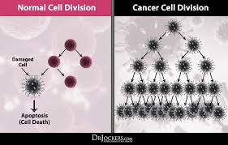
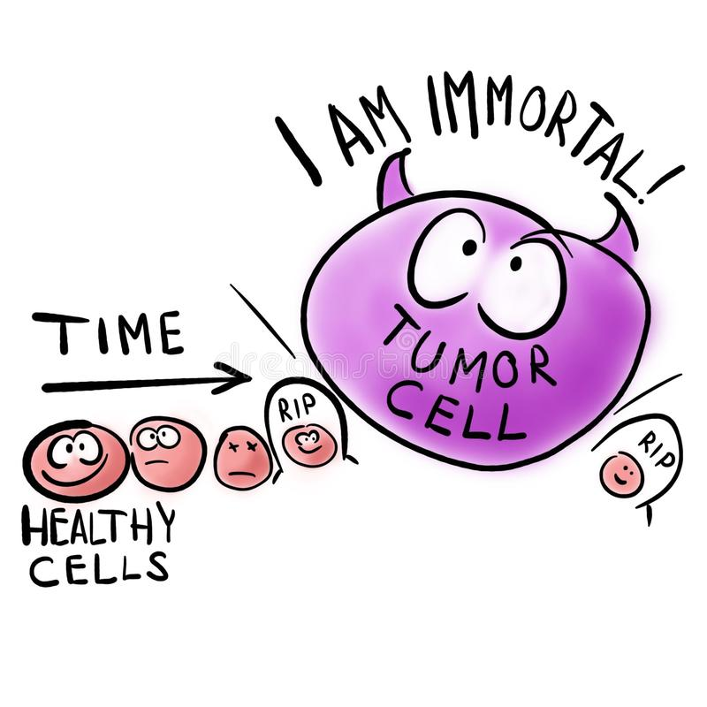
True
Notes:
True. Cancer cells are considered immortal. Normal cells can divide around 50 time before they lose their ability to replicate. Cancer cells have acquired mutations that allow them to divide indefinitely.
Images from drjockers.com, dreamstime.com

Slide 15
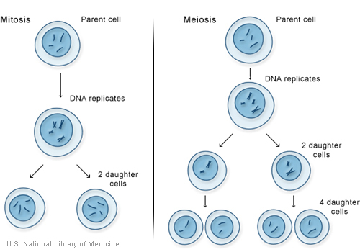
Cancer: True or False?
Cancer cells grow and divide in a controlled fashion.
Notes:
Solicit student feedback or ask for a show of hands if they believe this is true.
Image from ghr.nlm.nih.gov

Slide 16
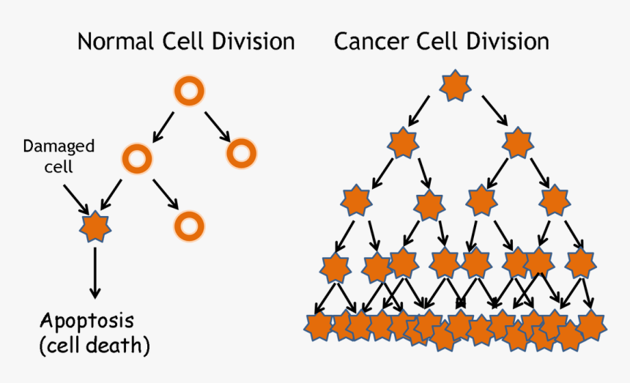
False
Notes:
False. Cancer is defined as the uncontrolled growth of abnormal cells.
Image from thestatesman.com

Slide 17
Cancer: True or False?
We currently have cures for cancer, but the medical industry keeps them from the
public because they make so much money treating cancer patients.
Notes:
Solicit student feedback or ask for a show of hands if they believe this is true.
Image from npr.org

Slide 18
False
Notes:
False. Doctors and their loved ones also get cancer and would benefit from a cure. If there were a cure for cancer sharing it would bring enormous positive publicity and probable financial gain.
Image from teregycoleman.com

Slide 19
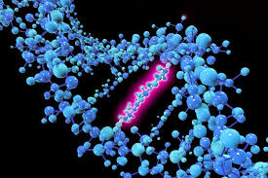
Cancer: True or False?
Cancer develops because of changes in our DNA that result in abnormal gene function.
Notes:
Solicit student feedback or ask for a show of hands if they believe this is true.
Image from thoughtco.com

Slide 20
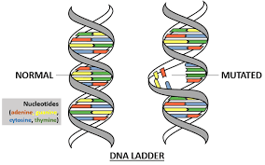
True
Cancer is a genetic disease caused by changes in genes that normally control the growth and death of cells.
Notes:
True. Cancer is a genetic disease caused by changes in genes that normally control the growth and death of cells. In the upcoming units we will be taking a closer look at the genetic basis of cancer, cancer risk factors and cancer disparities.
Image from melexgx.com

